Slide 1
Image fusion using Deep learning

Slide 2
Contents
Objective
Introduction
Literature Review
Problem Statement
Proposed Work
Algorithm
Block Diagram
Mathematical Model

Slide 3
Contents
Simulation Tool/ Equipment's/ Components
Conclusion
References
Work Plan

Slide 4
Objective
The project’s objective is to obtain a fused image by combining CT and MRI images.
The motivation is to obtain a superior exquisite image that will provide accurate and reliable statistics than any single image while retaining the best functions for the snapshots software program for medically testing, diagnosing and curing diseases.

Slide 5
Introduction
Human diseases are increasing day by day. Digital Image processing plays a vital role in medical field to get an enhanced image or to extract some useful information from it. In this project , we are going to combine Computed Tomography (CT) and Magnetic Resonance Image (MRI) to obtain clear image and this clear fused image has precise information compared with the original images.

Slide 6
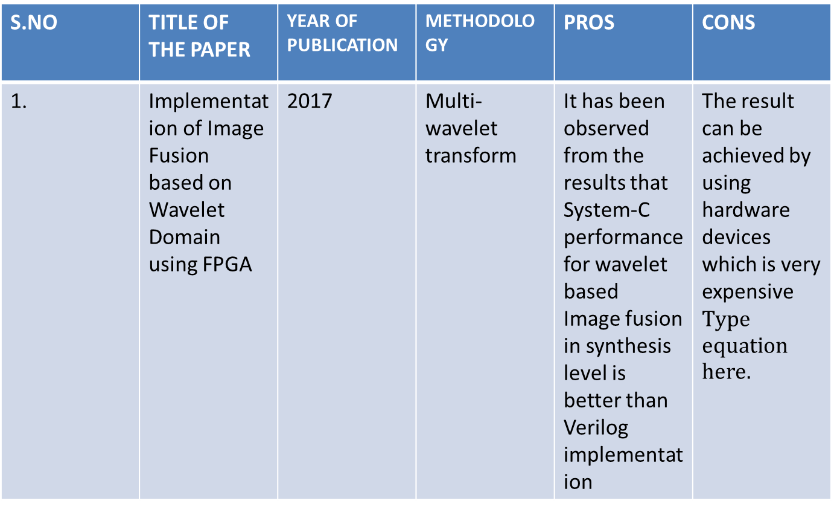
Literature Review
S.NO | TITLE OF THE PAPER | YEAR OF PUBLICATION | METHODOLOGY | PROS | CONS
1. | Implementation of Image Fusion based on Wavelet Domain using FPGA | 2017 | Multi-wavelet transform | It has been observed from the results that System-C performance for wavelet based Image fusion in synthesis level is better than Verilog implementation | The result can be achieved by using hardware devices which is very expensive

Slide 7
Problem Statement
This project addresses the problem of Clinicians suffering from inaccurate images for analysis.

Slide 8
Proposed work
Algorithm
Block Diagram
Mathematical model

Slide 9
Proposed Work Algorithm
Discrete Wavelet Transform
Wavelet transform provides high frequency resolution at low frequencies and high time resolution at high frequencies. A discrete wavelet transform (DWT) is a wavelet transform for which the wavelets are discretely sampled.

Slide 10
Proposed Work Algorithm
Transfer Learning
Transfer learning is an optimization that allows rapid progress or improved performance when modeling the second task. We aim to use the VGG-19 CNN architecture with its pre-trained parameters which would help us to achieve our target. Visual Geometry Group (VGG-19) is a convolutional neural network that is trained on more than a million images from the ImageNet database. The network is 19 layers deep and can classify images into 1000 object categories.

Slide 11
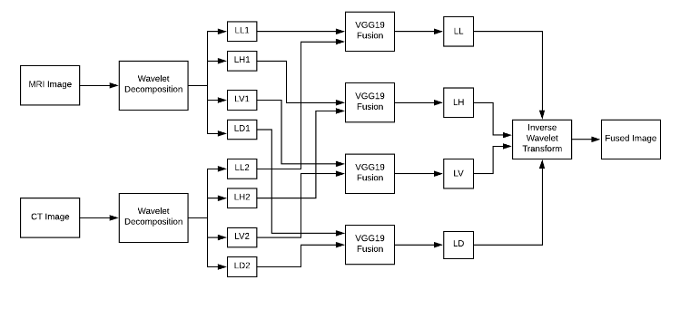
Proposed Work Block Diagram

Slide 12
Proposed Work Mathematical model
Apply wavelet decomposition on CT image to generate approximate coefficient LL1 and three detail coefficients: LH1(horizontal), LV1(vertical), LD1(diagonal)
Apply wavelet decomposition on MR image to generate approximate coefficient LL2 and three detail coefficients: LH2(horizontal), LV2(vertical), LD2(diagonal)
Apply fusion based on VGG-19 network on four pairs: (LL1 and LL2), (LH1 and LH2), (LV1 and LV2) and (LD1 and LD2), to generate LL band, LH band, LV band and LD band.

Slide 13
Simulation Tool/ Equipments/ Components
Hardware specifications:
Microsoft /Linux Server enabled computers, preferably workstations
Higher RAM, of about 4GB or above
Processor of frequency 1.5GHz or above
Software specifications:
Microsoft/Linux Server 2016 or 2019
Anaconda software

Slide 14
System Design
System Architecture
DFD Diagram
UML Diagrams
Activity Diagram
Use Case Diagram
ER Diagram
Sequence Diagram

Slide 15
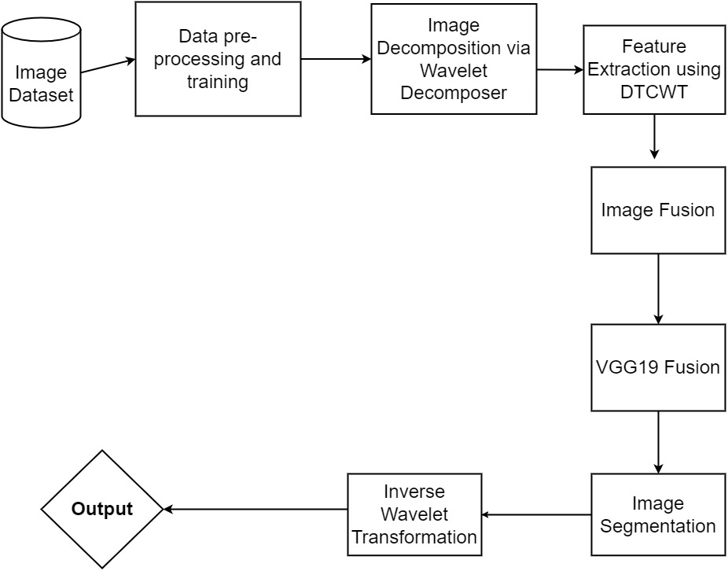
System Architecture

Slide 16
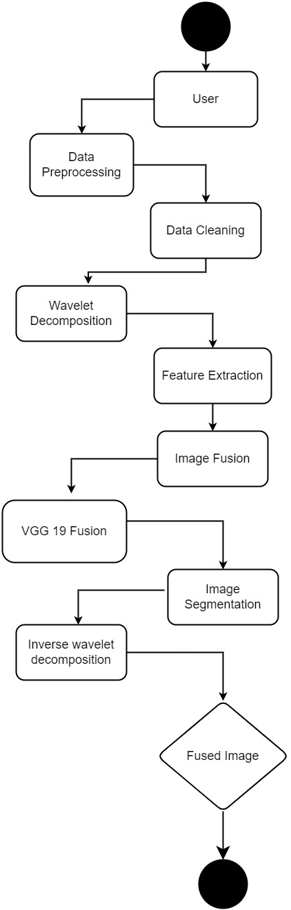
Activity Diagram

Slide 17
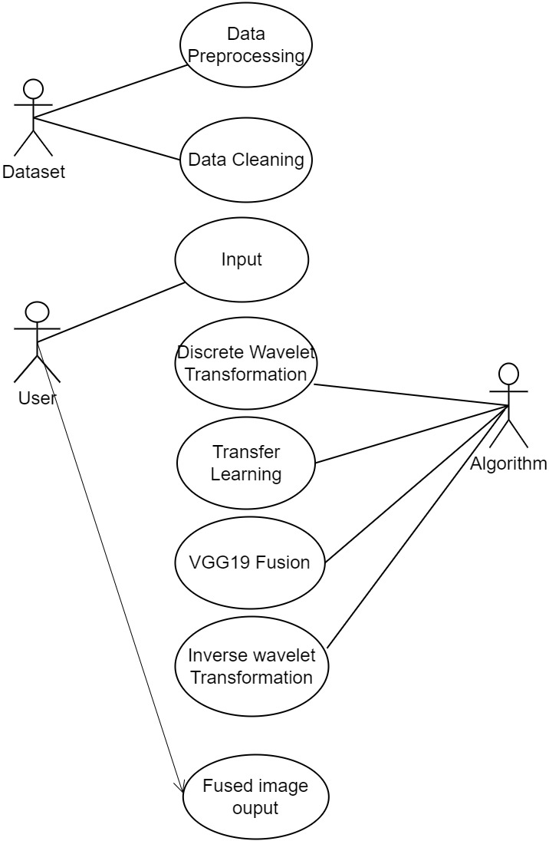
Use Case Diagram

Slide 18
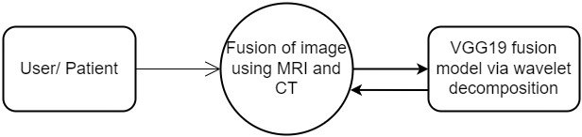
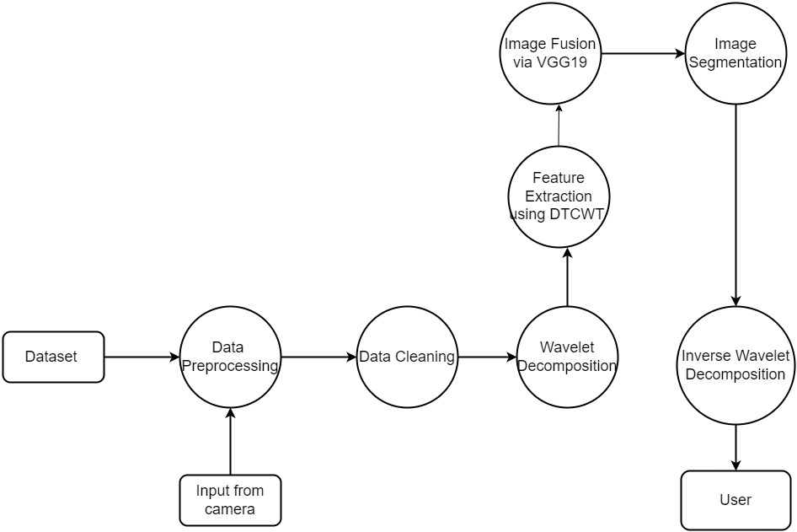
DFD 0 and 1 Diagrams

Slide 19
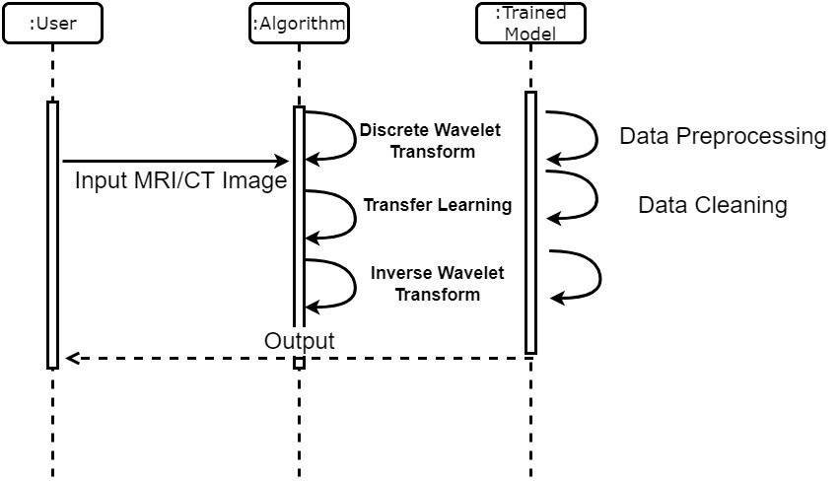
Sequence Diagram

Slide 20
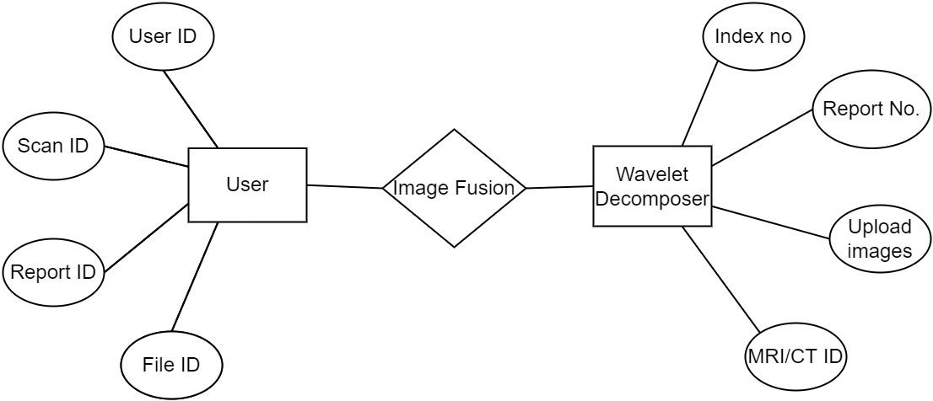
ER Diagram

Slide 21
Module Split-Up
Module 1: Image Decomposition
Module 2: Extracting Feature using DTCWT
Module 3: Image Fusion
Module 4: Image Segmentation

Slide 22
MODULE 1: Image Decomposition
In this module, we developed a website, which will prompt the user to upload the CT and MRI image of a patient.
The CT and MRI image will be in the size of 512*512. and also we need to give the input as the maximum coordinate, to fix the coordinate in the uploaded source image for the purpose of fusion.
The uploaded image is in the form of RGB. This RGB image is converted into a grayscale image, which has intensity information. After that, these source grayscale, CT, an

Slide 23
MODULE 2: Extracting Features using DTCWT
After decomposition we will extract the high intensity and low-intensity features as wavelet coefficients. It produce the various levels of decomposed images.
The principal component analysis is used to reduce the dimension of the data, if the data is larger in size, also extract the silent and complementary features. As the medical images are larger, to reduce the data here, PCA is used. The PCA will remove the unwanted and repeated information present in DTCWT. The PCA analysis has several steps. The first is standardization, the objective of this step is to standardize the range of the continuous initial variables. So, each will contribute equally to the analysis.

Slide 24
MODULE 3: Image fusion
The extracted coefficients are approximated. Finally, we get the approximated wavelet coefficients. Now the image fusion, that is approximated coefficients are fused to get the fused coefficients. Now we apply the Inverse dual-tree complex wavelet transform to restore the fused image.

Slide 25
MODULE 4: Image segmentation
The segmentation is used to differentiate the details of lines, curves, and boundaries. So, the segmentation is performed on the final fused image.

Slide 26
Algorithm Used
Discrete Wavelet Transform
Wavelet transform provides high-frequency resolution at low frequencies and high time resolution at high frequencies. A discrete wavelet transform (DWT) is a wavelet transform for which the wavelets are discretely sampled.
Transfer Learning
Transfer learning is an optimization that allows rapid progress or improved performance when modelling the second task. We aim to use the VGG-19 CNN architecture with its pre-trained parameters which would help us to achieve our target. Visual Geometry Group (VGG-19) is a convolutional neural network that is trained on more than a million images from the ImageNet database. The network is 19 layers deep and can classify images into 1000 object categories.

Slide 27
Conclusion
The fused image can be really helpful for the surgeons and doctor to obtain a clear image and by extracting useful information from the image. Future work can be done by highlighting some of the cells that has the symptoms of brain tumor or any other in the fused image.

Slide 28
References
[1] Surya Prasada Rao Borra, Rajesh K. Panakala and Pullakura Rajesh Kumar ,“VLSI Implementation of Image Fusion Using DWT- PCA Algorithm with Maximum Selection Rule ,“ RajeInternational Journal of Intelligent Engineering & Systems,2019
[2] M. Pemmaraju, S. C. Mashetty, S. Aruva, M. Saduvelly, and B.B. Edara, “Implementation of image fusion based on wavelet domain using FPGA”, In: Proc. of International Conf. on Trends in Electronics and Informatics, pp.500- 504, 2017
[3] ] J. Agarwal and S.S. Bedi, “Implementation of hybrid image fusion technique for feature enhancement in medical diagnosis”, Humancentric Computing and Information Sciences, Vol.5, No.1, pp.3, 2015.

Slide 29
Work Plan
Activity/Time period | Jan(1-15) | Jan(16-30) | Feb(1-15) | Feb(16-28) | Mar(1-10) | Mar(11-20) | Mar(21-30)
Project title selection and base paper Confirmation | ✓
Literature review paper collection |  | ✓
Project paper submission |  |  |  | ✓ | ✓
Project Implementation |  |  | ✓ | ✓ | ✓ | ✓
Final review |  |  |  |  |  |  | ✓

Slide 30
Thank You

